Slide 1
MIS 3301 Intro. to Business Programming Logic
Lists & Tuples
Part 1: Lists & Tuples - Create, Read, Update, Delete
Mrs. Nancy G. Sánchez

Slide 2
Outline
Part 1 – Working with 1D Lists
Sequences
Working with 1D Lists
Create
Read
Update
Delete
Working with 1D Tuples
Create
Read
Update
Delete

Slide 3


Sequence
Sequence is an ordered set; it holds multiple items of data stored one after the other.
Sequences include Range objects, Strings, Lists and Tuples.
Sequences are Iterables - an object that can be iterated over with a loop.
The elements can be accessed via an index.
Range
any_range = range(10,13)
Immutable
Ch 4 Loops
String
any_string = 'abc'
Immutable
In Ch 8 Strings, we will work with strings as a sequence
List
any_list = ['a', 'b', 'c']
Mutable
Tuple
any_tuple = ('a', 'b', 'c')
Immutable
Pronounced both tuh-ple or too-ple.

Slide 4
Lists

Slide 5
4 Main Operations
For any object, always make sure you first know the 4 main operations:
CREATE a List
READ from a List
Read all elements – FOR Loop, WHILE loop
Read one element
UPDATE a List
Update all elements – WHILE loop
Update one element
DELETE a List
Delete an entire List
Delete one element in a List - this is covered later under List Methods

Slide 6

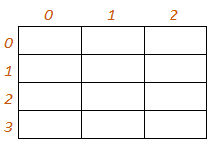
CREATE a List
We are currently creating 1-Dimensional (1D) Lists
names = ['Bob', 'Sue', 'John']
subscript/index
names[0]
names[1]
names[2]
i.e. “names sub 1”
Note: what makes the names list a 1D list is the single set of brackets. With 2D Lists we will use more brackets and the data will be tabular and have 2 indexes/subscripts for rows & columns.
i.e. “names index 1”
myData = [ [ ___, ___, ___ ]
[ ___, ___, ___ ]
[ ___, ___, ___ ]
[ ___, ___, ___ ] ]

Slide 7
CREATE a List
An empty List
empty_list = []
[]
to add elements later
List of Strings
names = ['Bob', 'Sue', 'John']
['Bob', 'Sue', 'John']
List of Integers
ages = [18, 33, 22, 65]
[18, 33, 22, 65]
List of Floats
gpas = [3.8, 2.7, 4.0]
[3.8, 2.7, 4.0]
List of mixed types
any_data = [10, 'Bob', 3.3]
[10, 'Bob', 3.3]
Using Repetition
any_nums = [0] * 4
[0, 0, 0, 0]
to pre-initialize
Quickly create a List
of numbers in a range
numbers = list(range(1,101))
[1, 2, 3, 4 , … 99, 100]

Slide 8
READ a List
0 1 2 3
numbers = [40, 20, 10, 80]
-4 -3 -2 -1
Read one element
num = numbers[0]
40
num = numbers[-1]
80
Read all elements
print(numbers)
[40, 20, 10, 80]
Do not dispay like this for a user
Loop through a List
for num in numbers:
print(num)
40
20
10
80
Use a FOR loop (instead of WHILE) when:
reading an entire list
not updating any values
i = 0
while i < len(numbers):
print(numbers[i])
i += 1
40
20
10
80

Slide 9
UPDATE a List
0 1 2 3
numbers = [40, 20, 10, 80]
-4 -3 -2 -1
Update one element
numbers[3] = 999
[40, 20, 10, 999]
pos = 0
numbers[pos] = 5
[5, 20, 10, 80]
Update all elements
i = 0
while i < len(numbers):
numbers[i] *= 2
i += 1
[80, 40, 20, 160]

Slide 10
UPDATE a List cont.
import random
#Create the list (initialized with 10s)
any_nums = [10] * 5
#Update all elements
x = 0
while x < len(any_nums):
any_nums[x] += random.randrange(1,10)
x += 1
The list has to exist before updating; fyi: using Repetition
any_nums – before the loop
[10, 10, 10, 10, 10]
any_nums – after the loop
[18, 17, 14, 13, 15]
names = ['Bob', 'Sue', 'John']
pos = 0
while pos < len(names):
names[pos] += '@bu.edu'
pos += 1
names – before the loop
['Bob', 'Sue', 'John']
names – after the loop
['Bob@bu.edu', 'Sue@bu.edu', 'John@bu.edu']

Slide 11
DELETE a List
0 1 2 3
numbers = [40, 20, 10, 80]
-4 -3 -2 -1
Delete the entire List
del numbers
Delete an element in a List
* We will learn this in Part 2 – List Methods

Slide 12
LISTs – a summary
CREATE
UPDATE
Create a List
Update all elements
numbers = [40, 20, 10, 80]
[40, 20, 10, 80]
i = 0
while i < len(numbers):
numbers[i] *= 1.1
i += 1
READ
[44.0, 22.0, 11.0, 88.0]
Read one element
num = numbers[2]
10
* Cannot update a List with a FOR loop
Read an entire List – using FOR
40
20
10
80
for num in numbers:
print(num)
DELETE
Delete the entire List
Read an entire List – using WHILE
del numbers
i = 0
while i < len(numbers):
print(numbers[i])
i += 1
40
20
10
80
Delete an element in a List
* We will learn this in Part – List Methods

Slide 13
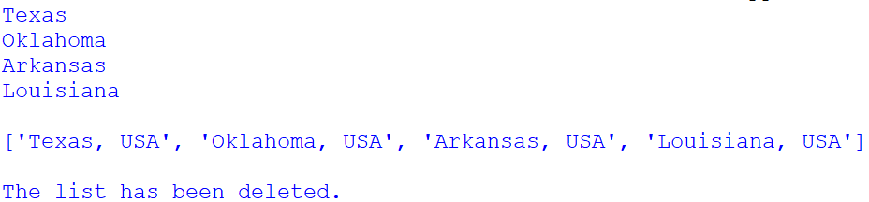
Exercise 1 – List (CRUD Processing)
Copy the starter code below and save it as Ch7-Ex01-CRUD-List.py
#Ch7-Ex01-CRUD-List.py
#CREATE a list
'Texas', 'Oklahoma', 'Arkansas', 'Louisiana', 'New Mexico'
#READ - loop to display each state on a different line
#UPDATE - loop to update each state by concatenating “, USA” to the end of each value
#Display the list (as is)
#DELETE the list – note: this is not necessary (as it will be deleted automatically from memory once our function ends)
Write code to display the following:

Slide 14
Tuples
Tuples are similar to Lists except Tuples are immutable
Immutable – i.e. once created there elements cannot be updated
Will use parentheses to define tuples instead of brackets.

Slide 15
TUPLEs – a summary
0 1 2 3
numbers = (40, 20, 10, 80)
CREATE
-4 -3 -2 -1
UPDATE
Create a Tuple
numbers = (40, 20, 10, 80)
(40, 20, 10, 80)
* Cannot update a Tuple since they are immutable
READ
Read one element
num = numbers[2]
10
Read an entire Tuple – using FOR
40
20
10
80
for num in numbers:
print(num)
DELETE
Delete the entire Tuple
Read an entire Tuple – using WHILE
del numbers
i = 0
while i < len(numbers):
print(numbers[i])
i += 1
40
20
10
80
Delete an element in a Tuple
* Cannot update a Tuple since they are immutable

Slide 16
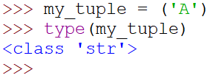
FYI only…. Warning: Creating a Tuple with only one Element
This issue ony happens with tuples and not with lists!
Creating a tuple with only 1 element
my_tuple = ('A')
print(type(my_tuple))
<class 'str'>
Oops, we intended to create a tuple with one element!
Solution: Add a comma!
my_tuple = ('A',)
print(type(my_tuple))
<class 'tuple'>
Do not forget that you can test this even faster in the Shell
…Even with variables
var = 'A'
my_tuple = (var,)
print('C:', type(my_tuple))
C: <class 'tuple'>

Slide 17
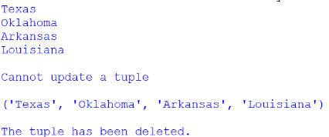
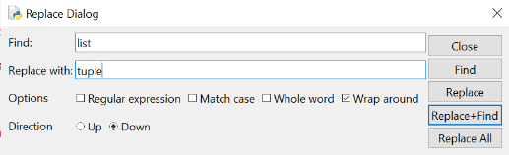
Exercise 2 – Tuple (CRUD Processing)
Open the previous file and save it as Ch7-Ex02-CRUD-Tuple.py
Redefine the states list as a tuple.
Replace all ocurrences of the word List to Tuple.
Write code to display the following:
Ctrl+H
What should we do with the UPDATE code? ________

